Slide 1
~ You are a marvel ~
Each second we live is a new and unique moment of
the universe, a moment that will never be again…
And what do we teach our children?
We teach them that two and two make four, and that Paris is
the capital of France. When will we also teach them what they are?
We should say to each of them:
Do you know what you are? You are a marvel.
You are unique. In all the years that have passed, there has never been
another child like you. Your legs, your arms,
your clever fingers, the way you move.
You may become a Shakespeare, a Michelangelo, a Beethoven.
You have the capacity for anything.
Yes, you are a marvel. And when you grow up, can you then
harm another who is, like you, a marvel?
You must work – we must all work – to make the world
worthy of its children.
Pablo Casals (1876-1973)

Slide 2
How to teach Software Engineering
There is not a single right way to teach software engineering
My approach is to teach what I’ve learned from experience and not simple textbook solutions
All engineering, including software engineering, is concerned with building useful artifacts under constraints (some people even define engineering to be “design under constraints”)
If it weren’t for the constraints, there might be a single right way to engineer software systems

Slide 3
What is Software Engineering?
The practical application of scientific knowledge to the design and construction of computer programs and the associated documentation required to develop, operate, and maintain them [Boehm].
The systematic approach to the development, operation, maintenance, and retirement of software [IEEE].
The establishment and use of sound engineering principles (methods) in order to obtain economically software that is reliable and works on real machines [Bauer].
Multi-person construction of multi-version software [Parnas].
“Software from womb to tomb.”

Slide 4
Why study Software Engineering?
Building software without discipline is crazy
Software is critical to society
Building a large complete software project is hard
There is a perceived crisis in our ability to build software
It’s fun!
$$$$

Slide 5
Software is critical to society
Economically important
Essential for running most enterprises
Key part of most complex systems
Essential for designing many engineering products
In many if not in most cases, the software is embedded in the system you are using — you don’t see the software

Slide 6
Software is big
Code sizes due to Jon Jacky (mostly); KLOC = 1000 lines of code; MLOC = 1,000,000 lines of code
Bar code scanners | 10-50KLOC
4-speed transmissions | 20KLOC
ATC ground system | 130KLOC
Automatic teller machine | 600KLOC
Call router | 2.1MLOC
B-2 Stealth Bomber | 3.5MLOC
Seawolf submarine combat | 3.6MLOC
NT 4.0 | 10MLOC
NT 5.0 (NTFS alone) | 60+LMLOC (250K source lines or 100KLOC )

Slide 7
Software it big, so what?
Delivered source lines per person
Common estimates are that a person can deliver about 1000 source lines per year (including documentation, scaffolding, etc.)
Therefore, most complex systems require many people to build
This would be true even with an order of magnitude increase in productivity
Hence the critical need for coordination
Brooks reminds us that people ≠ time

Slide 8
“The Software Crisis”
We’ve been in the midst of a crisis ever since the 1968 NATO meeting that christened software engineering
“We are unable to produce or maintain high-quality software at reasonable price and on schedule.”
“Software systems are like cathedrals; first we build them and they we pray. [Redwine]"

Slide 9
To some degree this is accurate
We’ll look at some classic software failures later on in the quarter
But it’s not fully accurate
Given the context, we do pretty well
We surely can, should and must improve
Some so-called software “failures” are not
  They are often management errors (the choice not to do something that would have helped)
In some areas, in particular safety-critical real-time embedded systems, we may indeed have a looming crisis

Slide 10
Some “crisis” issues
Relative cost of hardware/software
Low productivity
“Wrong” products
Poor quality
Constant maintenance
Technology transfer is slow

Slide 11
Why is it hard?
There is no single reason software engineering is hard—it’s a “wicked problem”
Lack of well-understood representations of software makes customer and engineer interactions hard [Brooks]
Still a relatively young field
Software intangibility is deceptive
  Norman Augustine [Wulf]: “Software is like entropy. It is difficult to grasp, weighs nothing, and obeys the second law of thermodynamics; i.e., it always increases.” [Law XXIII]

Slide 12
As the size of the software system grows, the dominant discipline changes (due to Stu Feldman)
Code Size (LOC) | Dominant Discipline
10³ | Mathematics
10⁴ | Science
10⁵ | Engineering
10⁶ | Social Science
10⁷ | Politics
10⁸ | Legal?

Slide 13
Software lifecycle
A software engineering lifecycle model describes how one might put structure on the software engineering activities
The classic lifecycle model is the waterfall model (roughly due to Royce in 1956), which is structured by a set of activities and is inherently document-driven

Slide 14
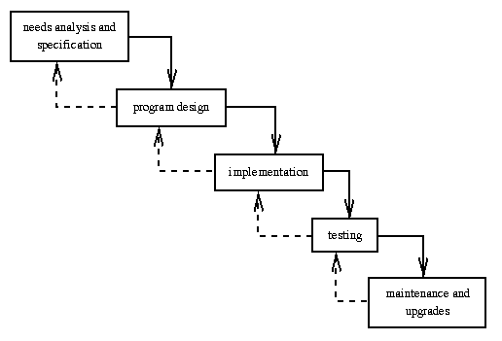
Software lifecycle

Slide 15
Software lifecycle
Limited feedback increases risk
“You start at the top and it’s all downhill from there.” [uncertain origin]
The cost of fixing errors at later lifecycle phases is much higher than at earlier stages
  Boehm’s 1976 data still hold — the differences are often an order of magnitude
  Must increase feedback in the lifecycle to reduce these costs (and other risks)

